Slide 1
PROMOTION REPORT
Optimize the OQC management process by software
& standardize electronic stamps
MAIN CONTENTS
1
Job History & Achievement
Page 1
2
Background Of Activities
Page 2~3
3
Total Improvement Schedule
Page 4
4
Detail Improvement Activity
Page 5~7
5
Confirm result & Next activities
Page ..~..
Presented by : Nguyen Nhu Minh
Join Date : 12-Feb-2019
Current Position : Officer (6 years)
New Position : Supervisor
Section : DEV
Notes:
0.5m
Good morning/afternoon/evening everyone,
My name is Minh ,member of IT section. Today, I am very honored to be here to present my promotion report.
My topic is : “Upgrade Factory Operation Support System (Foss) & Make Asset Life Cycle Management System”
My presentation have to 5 parts.
Let’s begin: I talk about my self.

Slide 2
Job History & Achievement (2019-2024)
2/10
1/9
1.Job History & Organization:
Time | Career History
Entrance | 12/02/2019
Apr 2022
My Responsibilities | ✓Develop software. ✓Support users and all systems of IT.
2.New Assignment:
Analysis
✓ Current job : Maintain developed Systems, Analyse, Design & Develop new systems, study system of company production to make software.
✓ Change mindset : Lead team (2 officer) beside my current jobs. Study more new technologies to develop software.
3.My main achievements (2019 – 2023)
Notes:
0.5m
Now, I introduce about my self.
I work here start February, 2019
We see in the ISD Organization, I’m working in Develop team. There are 4 peoples in my team. I’m a in charge of Software development.
New assignment after promotion: …
There are some my achievement. I had done many project with achieve cost down, reduce HC, ensure quantity for production.

Slide 3


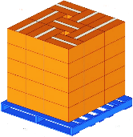
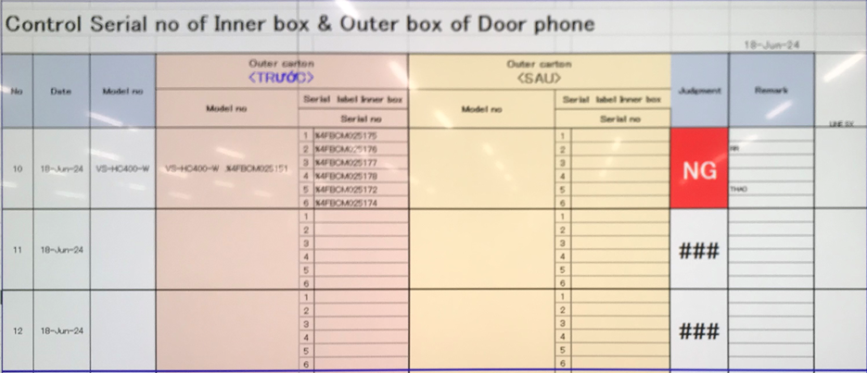
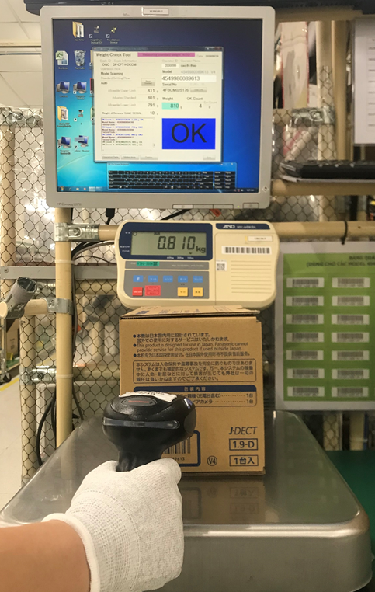
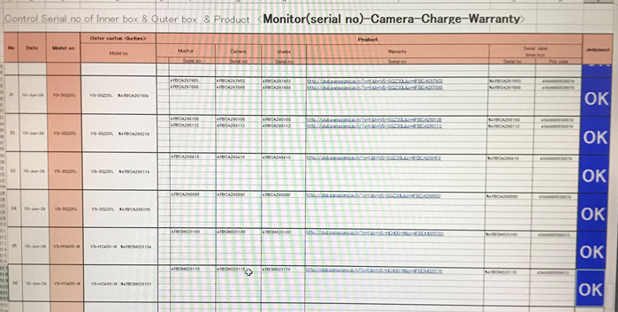
Background Of Activities
2/10
2/9
Strengthen factory streamline by IT automation for all Department
IQC
MCS
SMT
DIP
PMD
FA
SCM
E Chop system
Smart W/H control
Reel & PCB
Traceability
Warehouse software
Weight & Traceability
WMS & Tally Sheet
All departments have management systems and link together
Problem:
The entire OQC system is managed by Excel files and
is not linked to any system in the factory.
Pick up sample
First
check
Weight 1st
OQC inspection
Check
S/N inner
Weight 2nd
Second check
Return sample
Reliability
Activity 1
➢ Each step is independent, with no link to each other
➢ Risk quality: Skip process & misjudgment, human mistake
✓ Optimize all processes by software
✓ Target : Save time 1,000 H/Year
Issue 1
OQC procedure 100% manual control & not link other systems
Notes:
(1m)
The next, I talk about the background of activities.
- Let's look Project summary in 5-year. IT received a lot of number request . There is small of request is selected..
My Target : increase quantity project but actual the develop time still not enough.
Normal support is very height because all application on Handy terminal is running wince. Difficult to develop soft on them. Take long time to modify and build program. Sometime repair and setup Operation system when error. (There are a lot of software need support during operation. human error, machine error, or system error. I need to solve it for the system running again..)
The advantage of this action : reduce support time and increase develop time.
- other reason, Win CE end of line 2023. to comply company policy We need to upgrade win CE to android Operation system.
There is a large system of the factory that needs to be upgraded is FOSS
➔ This is reason I select issue 1.
Next slide, I talk about the background issue 2.

Slide 4





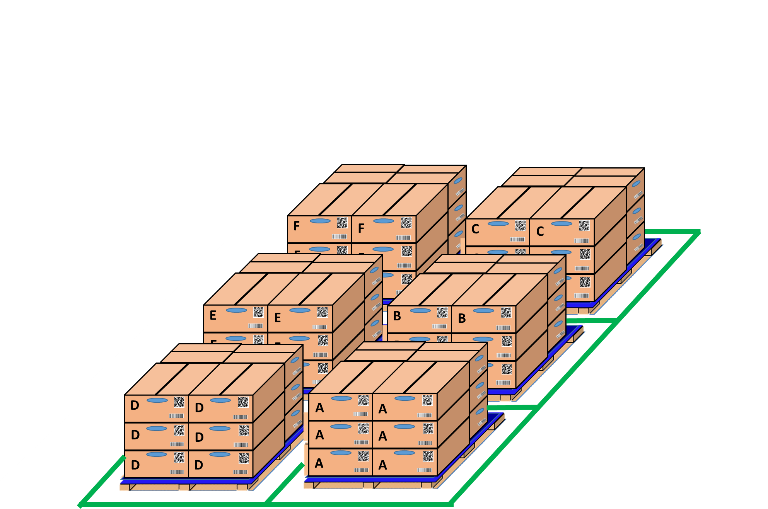


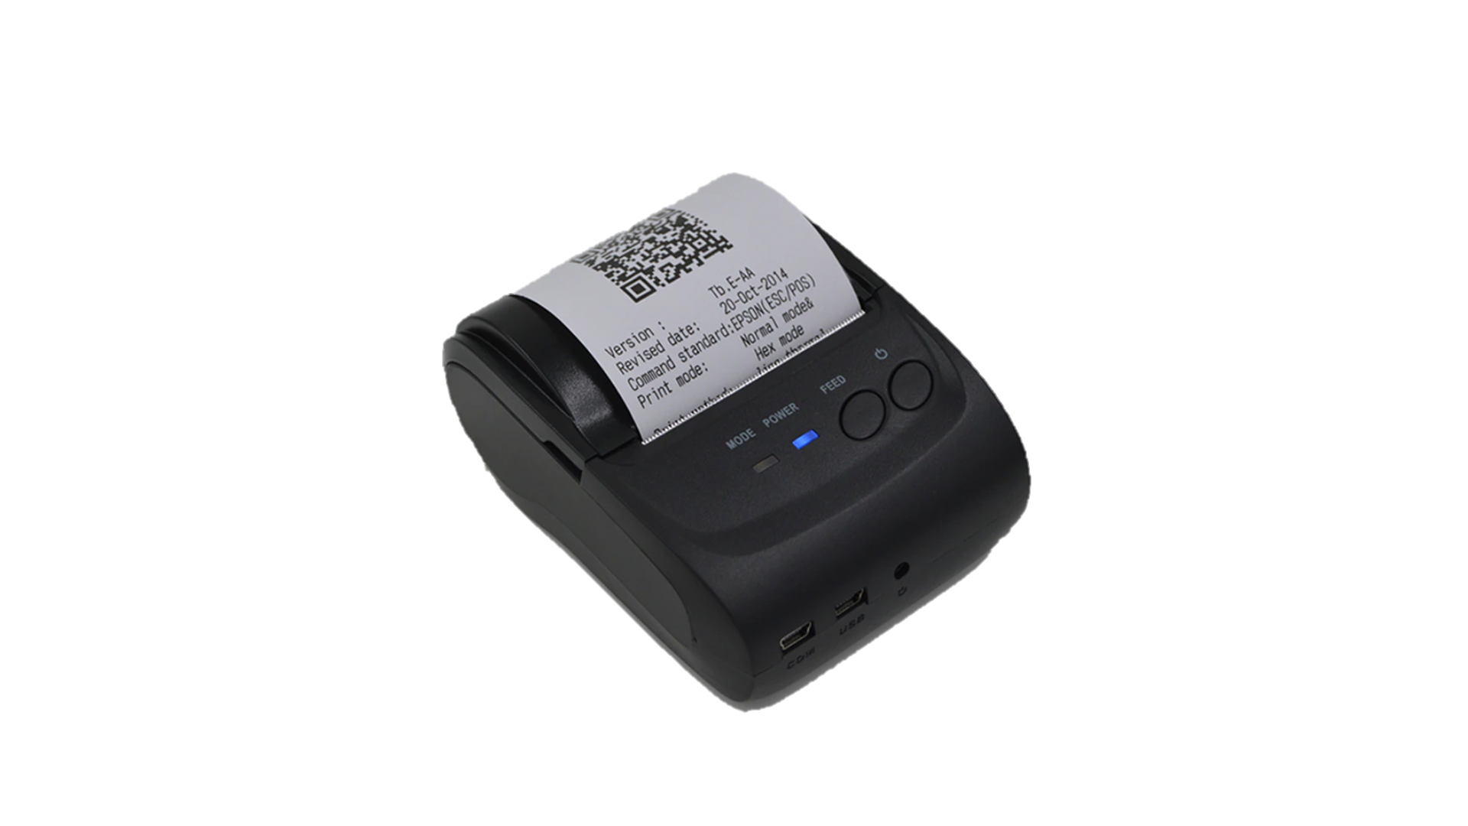
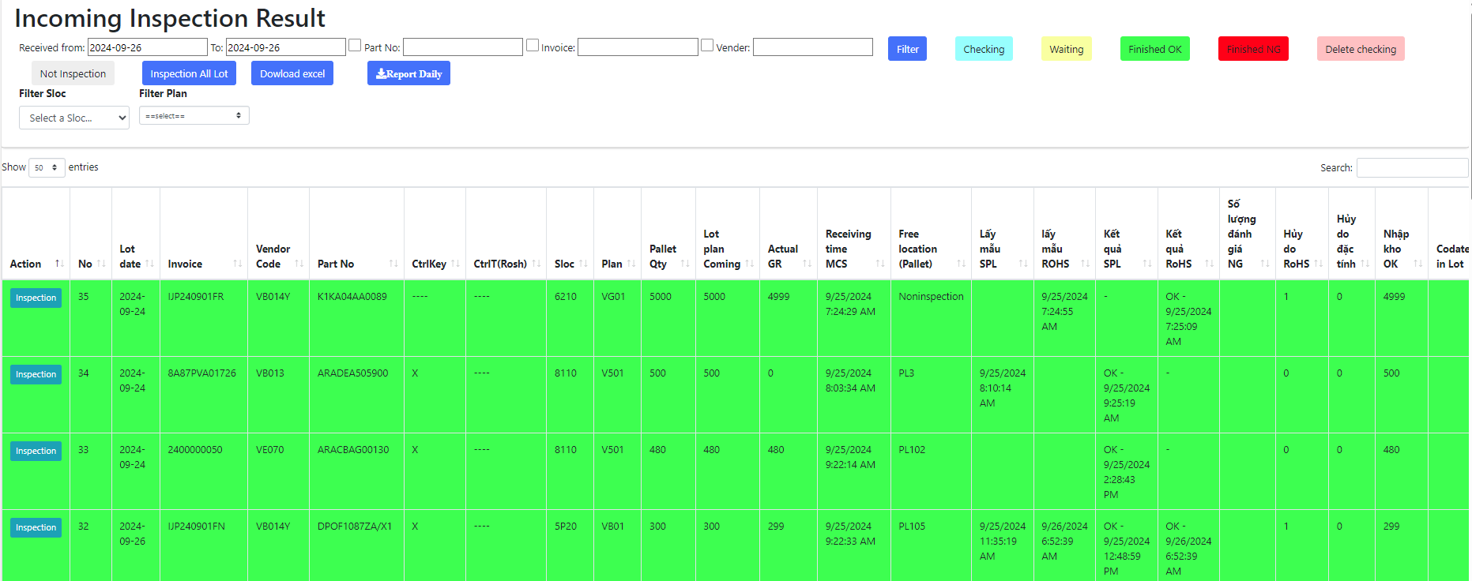

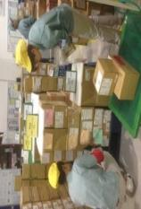
Background Of Activities
2/10
3/9
Electronic stamp for PSNV
Process IQC chop stamp before
After improvement
IQC inspection
IQC pick up sample
PQC
Sampling
MCS Scan 100% box
SWMS
MCS Scan GR at the receiving area
OK
OK
NG
OK
Day- Month- Year
PQC
NG
location
NG
NG
NG
NG
OK
Direct print
Paste
Day- Month- Year
OK
OK
PQC
IQC Inspection
Complete
OK
Fix location
MERIT
OK
Day- Month- Year
Cut 1 pax
Visualize the IQC inspection
PQC
IQC Loss time to find & physical stamp OK /NG
Replace physical stamp by electronic stamp for IQC
Problem:
OQC Loss time to find all the same lot to chop stamp physical.
Notes:
(1m)
- we are look at the ratio development team project:
following KPI annual we must complete is 30%, in addition to 10% of urgent projects . The rest of request is 60% from other departments. These are thing that we haven’t enough time to complete. Its content of other request related to:….
An example of other request, we look at the Current Asset Management IT: there are a lot of manual job, excel file and check sheet, papers.
For this reason, I select the issue 2 make an new system
current process: all step there are more 1 thousand items need to be managed.
(All these activities are manual job through papers, check sheet and excel file. It takes a lot of time to manage monthly inventory)
My action : using by barcode technology, scan barcode auto save database server
Apply new system, We save time management, reduce papers.

Slide 5
Total Improvement Schedule
1/10
4/9
Issue | Items | Activity Content | In charge (Main) | WHEN (Jul.2023) |  |  |  | TARGET
 |  |  |  | Q1 | Q2 | Q3 | Q4
Upgrade FOSS
Issue ①
Issue ②
Plan:
Actual:
Notes:
0.5m
Next slide, I talk about the total improvement schedule
the issue 1, upgrade to FOSS from win CE to other OS.
[2] analyze and optimize all process of Foss -> develop all functions-> target :…
The issue 2: [1] Study management asset -> clear process and function .
After that , I select the device and develop software. -> target : ….
Next slide, I will explain more detail for issue 1.

Slide 6
Detail Improvement Activity
1/10
5/9
Notes:
1m
About issue 1, Follow company policy, Windows CE will be end of life 2023.
Current situation:
All Applications are running on Wince
Normal support is very height
Solution:
- Select new language & new OS -> develop new software
upgrade FOSS => reduce support time.
My action :
I have choose Flutter language. Because it is used to develop applications for mobile devices. Runs on both Android and IOS platform, desktop applications and web applications. (Develop software slow, Not responsive to big data system, Regularly repair and setup window again)
The Android OS is quite commonly used and integrates many scanning devices. So that I have selected android platform.
- Limit Wince : …. => The advantage when use flutter to develop software: make faster, stable software.
Result : let look at total devices need to upgrade new software. MCS department : 109PCS, other department: 6 pcs
Now I go to the functions detail of FOSS.
Improvement result after upgrade:
- Increate develop time , reduce support time

Slide 7
Detail Improvement Activity
1/10
6/9
Notes:
1m
Next slide, I talk a bout the detail of development FOSS
Current situation:
- There a lot of functions (65 screens)
- There are many similar functions
- Many request improvement quality activities from the department
Solution: Improve & Optimize system
Action (There are 4 step. GR, storage, kitting and supply -> there are a lot of functions) -> total functions…
After analyze , discus with pic MCS we combine some the same function, reduce screen, optimize the process to reduce the operators. Result: => make new software to upgrade on mobile.
Total function reduce 65 to 32. (-> Amount of working is big to develop. Research new technology to apply and own.)
- Support time reduce 35%.
Now, I move to next issue 2,

Slide 8
Detail Improvement Activity
1/10
7/9
Notes:
1m
This slide I talk about detail activities of issue 2:
Current situation:
Too much manual job, papers, excel file
The equipment is not barcoded
Take a long time to inventory, make report and trace history.
Current situation:
Survey all process, analysis and design
Make tool create barcode => Issue barcode to identify equipment
Build standard process of manage asset, develop software.
Action: Apply scan barcode for each step reduce paper and manual job, check sheet and excel file.
- When borrow & return equipment scan item & user ID card replace record paper. (delete)
- When transfer or inventory scan user's card to identify and fix location replace count manual pc. (delete)
- With stationery warehouses, input and output items, have to scan barcodes to control them. (delete)
=> After scan barcode -> Data result auto save database server via access point. Reports auto visualization on website.
Merit :
Apply this system, you will control easy equipment and specially we will save 60% time management and 80% print paper.
In the future expand other department.
The next slide to confirm result.

Slide 9
Detail Improvement Activity
1/10
8/9
Notes:
1m
This slide I talk about detail activities of issue 2:
Current situation:
Too much manual job, papers, excel file
The equipment is not barcoded
Take a long time to inventory, make report and trace history.
Current situation:
Survey all process, analysis and design
Make tool create barcode => Issue barcode to identify equipment
Build standard process of manage asset, develop software.
Action: Apply scan barcode for each step reduce paper and manual job, check sheet and excel file.
- When borrow & return equipment scan item & user ID card replace record paper. (delete)
- When transfer or inventory scan user's card to identify and fix location replace count manual pc. (delete)
- With stationery warehouses, input and output items, have to scan barcodes to control them. (delete)
=> After scan barcode -> Data result auto save database server via access point. Reports auto visualization on website.
Merit :
Apply this system, you will control easy equipment and specially we will save 60% time management and 80% print paper.
In the future expand other department.
The next slide to confirm result.

Slide 10
Confirm result
1/10
9/9
65 % Development
Notes:
0.5M
Following the schedule:
Issue 1:…
Result: normal support reduce form 45 -> 35, develop time increase 55 -> 65
Issue 2:…
Save time inventory: 1142 Hour => 380h, Reduce paper : 70ram -> 10ram
======== // calculator // ======
Save Time develop: 1h * 4per = 4hour / day
Save cost: 20 * 4 * 2.5 = 200$/ M ~ 2400$ /Y
Inventory pc:
Before: total time using: 3min/60*20*1142 pcs =1142 Hour / month
After: 1min/60*20*1142 pcs = 380.6 Hour /month
Total paper using : before = 70ram, after = 10ram

Slide 11
Next activities
1/10
10/9
Notes:
1m
The last slide I talk about the next activities:
For my team: learning, sharing, knowledge, experience for other member -> My goal :….
For myself: study method issue and solve problem, control schedule keep on time. Find the best solution to save time…
Next activities: ….
That all my report. Thanks for your listening!
If do you have any question, please let me know?

Slide 12
Activity 1: Electronic standardization of stamps for IQC departments
Summary Merit if IQC no chop stamp on actual Pallet & Box/ Hopper
Item | Detail | Unit | No | Before |  |  |  | After
 |  |  |  | PL part | Electric Part | Mecanical part | RoHS | PL part | Electric Part | Mecanical part | RoHS
Incoming lot | Average number of lots coming in a month (inspection) | Lot | (1) | 507 | 369 | 2681 | 960 | 507 | 369 | 2681 | 960
 | Average number of pallets / 1 Lot incoming | Palet | (2) | 3 | 3 | 3 | 3 | 3 | 3 | 3 | 3
 | Average number of boxes, hoppers/ 1 Pallet | Box | (3) | 15 | 13 | 5 | 7 | 15 | 13 | 5 | 7
Time for chop stamp | Time to move and stamp OK/NG for 1 receiving card/1 Pallet (seconds) | Second | (4) | 10 | 10 | 10 | 10
 | Time check stamp for 1 box (seconds) | Second | (5) | 10 | 5 | 5 | -
 | Date Code / Batch Time Record (seconds) | Second | (6) | 180 | 45 | 45 | - | 180 | 45 | 45 | -
 | Time to move to warehouse for return and stamping/ 1 Lot | Second | (7) | 120 | 120 | 120 | 120 | 120 | 120 | 120 | 120
 | Total time / Lot = (4*2)+(5*3*2)+(6) +(7) (second) | Second | (8) | 780 | 390 | 270 | 150 | 300 | 165 | 165 | 120
Total Time / month = 8*1 (Hours) |  | Second | (9) | 395,460 | 143,910 | 723,870 | 144,000 | 152,100 | 60,885 | 442,365 | 115,200
Different (Hours) |  | Hour |  | 391 |  |  |  | 214
 |  |  |  | 177
Final summary
Working time 1 pax / 1Month | 192 | Hours
Can save time if delete chop stamp | 177 | Hours
Save manpower / month | 0.92 | Pax

